Slide 1
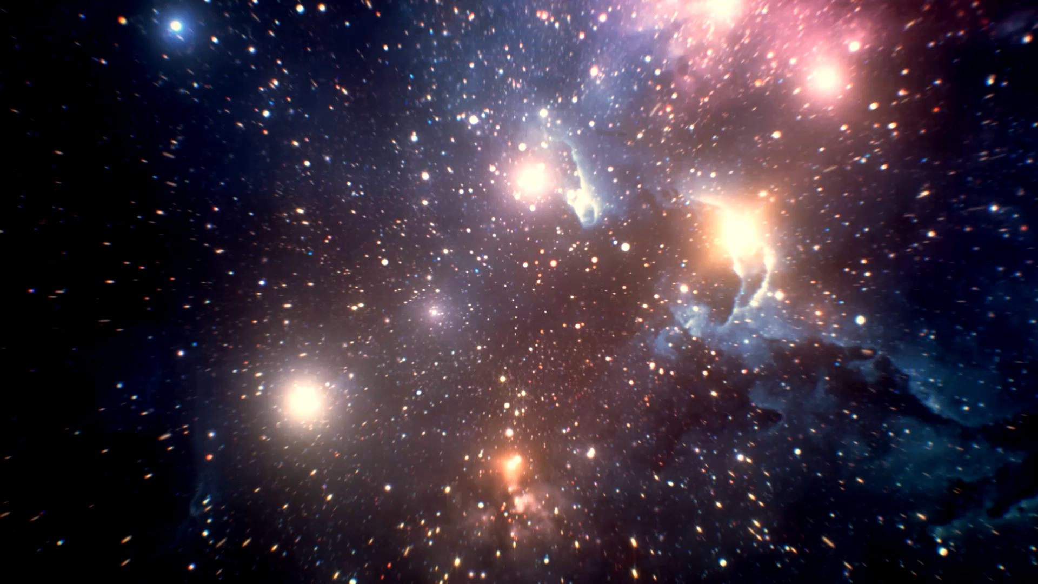
Big Bang Nucleosynthesis
THE UNIVERSE
IS #10 (week 11)

Slide 2

The early Universe is Radiation-dominated. Why?
$ρ_{rad}∝S^{−4}$ , $ρ_{matter}∝S^{−3}$
Sketch the energy densities against scale factor in log-log scale.
lg ρ
Radiation
Matter
lg S

Slide 3
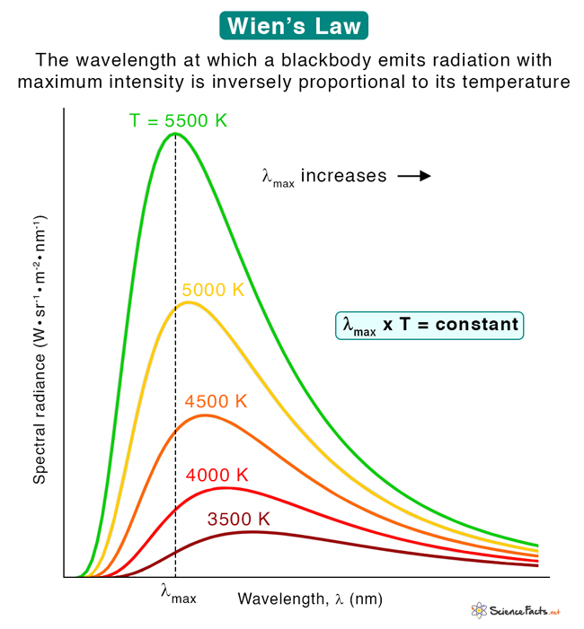


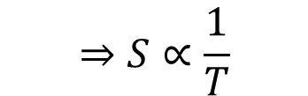
The Universe is one huge Blackbody
(Energy) Distribution of photons at a given temperature.
$$⇒S∝\frac{1}{T}$$
$$λ_{mode}T=constant$$
$$λ_{mode}$$

Slide 4

Temperature scales inversely with the size of the Universe
$$S∝T^{−1}$$

Slide 5
The early Universe was radiation dominated.
What about matter? Is there any matter?
Yes! We need them to exist to make the elements!
Constant scattering between photons & matter.
Photons and matter in thermal equilibrium.

Slide 6
Why is it important to consider temperature for Big Bang Nucleosynthesis?
Nuclear reaction rates depend on temperature.
The size of the Universe depends on temperature.
The higher the temperature, the faster the expansion of the Universe.

Slide 7
We are now prepared to follow the course of cosmic evolution through the first three minutes. Events move much more swiftly at first than later, so it would not be useful to show pictures spaced at equal time intervals, like an ordinary movie. Instead, I will adjust the speed of our film to the falling temperature of the universe…
-- Adapted from Steven Weinberg’s The First Three Minutes

Slide 8
Big Bang Nucleosynthesis: Making the first elements
From a primordial soup of fundamental particles (protons, neutrons, electrons, etc) to…
Z | Element | Mass fraction (ppm)
1 | Hydrogen | 739,000
2 | Helium | 240,000
8 | Oxygen | 10,400
6 | Carbon | 4,600
10 | Neon | 1,340
26 | Iron | 1,090
7 | Nitrogen | 960
14 | Silicon | 650
12 | Magnesium | 580
16 | Sulfur | 440
~74%, protons.
~24%. Stellar nucleosynthesis models fails to produce this amount.
Produced in stars.
10 most common elements in the Milky Way
Croswell, Ken. Alchemy of the Heavens

Slide 9
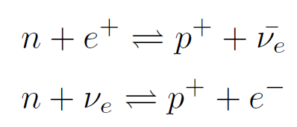
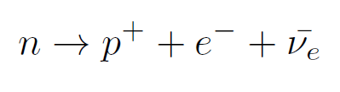
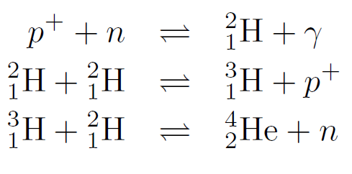
Big Bang Nucleosynthesis: Making the first elements
Neutrons becoming protons and vice versa
Neutrons decaying into protons
Proton and neutron combine to become deuterium
Tritium produced
Helium produced

Slide 10
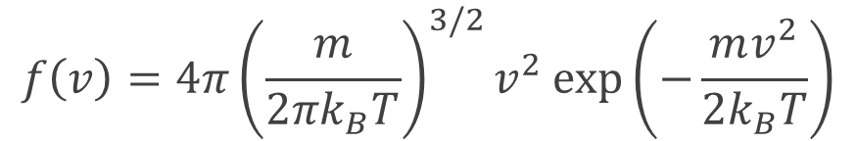

Big Bang Nucleosynthesis: Making the first elements
We’re interested to know the distribution of particle at a given temperature.
$$f\left(v\right)=4π{\left(\frac{m}{2πk_{B}T}\right)}^{3/2}v^{2}\exp\left(−\frac{mv^{2}}{2k_{B}T}\right)$$
Maxwell Boltzmann distribution
Plot this out on Desmos!
$$Use m=m_{p}, T={10}^{10}K$$

Slide 11
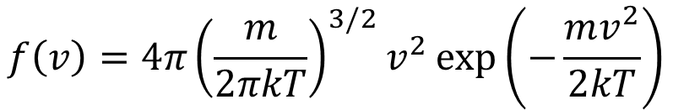
What is the mode velocity and kinetic energy for a Maxwell-Boltzmann distribution?
$$f\left(v\right)=4π{\left(\frac{m}{2πkT}\right)}^{3/2}v^{2}\exp\left(−\frac{mv^{2}}{2kT}\right)$$

Slide 12

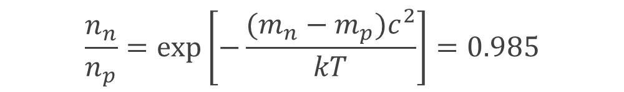
Big Bang Nucleosynthesis: Making the first elements
At $T={10}^{12}$ K
$kT≈1.381×{10}^{−11} J≫\left(m_{p}−m_{n}\right)c^{2}$
Proton and neutron constantly transforms from one to another at this temperature.
$$\frac{n_{n}}{n_{p}}=exp\left[−\frac{(m_{n}−m_{p})c^{2}}{kT}\right]=0.985$$

Slide 13
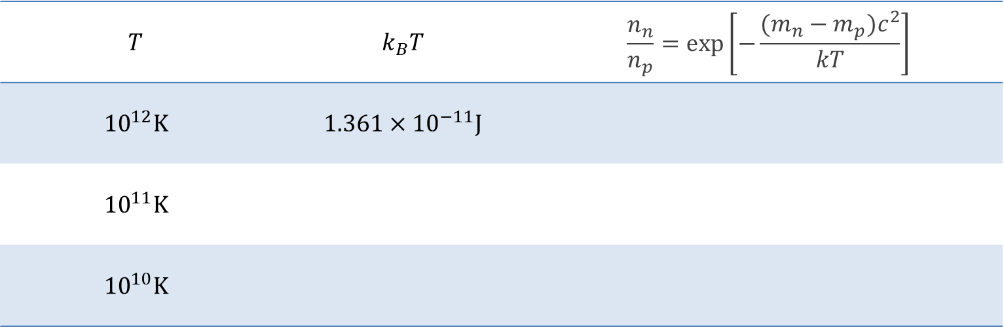


Fill in the table below
$$Mass of Proton m_{p}=1.672622×{10}^{−27}kg$$
$$\left(m_{n}−m_{p}\right)c^{2}=$$
$$Mass of neutron m_{n}=1.674927×{10}^{−27}kg$$
$$Mass of electron m_{e}=9.109384×{10}^{−31}kg$$
$$m_{e}c^{2}=$$

Slide 14

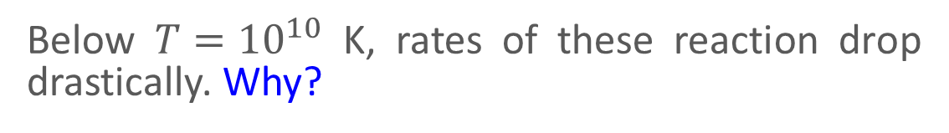
Big Bang Nucleosynthesis: Making the first elements
At $T={10}^{10}$ K, $\frac{n_{n}}{n_{p}}=0.223$
Below $T={10}^{10}$ K, rates of these reaction drop drastically. Why?
Ratio of neutrons and protons $\frac{n_{n}}{n_{p}}$ continue to drop via beta decay:

Slide 15

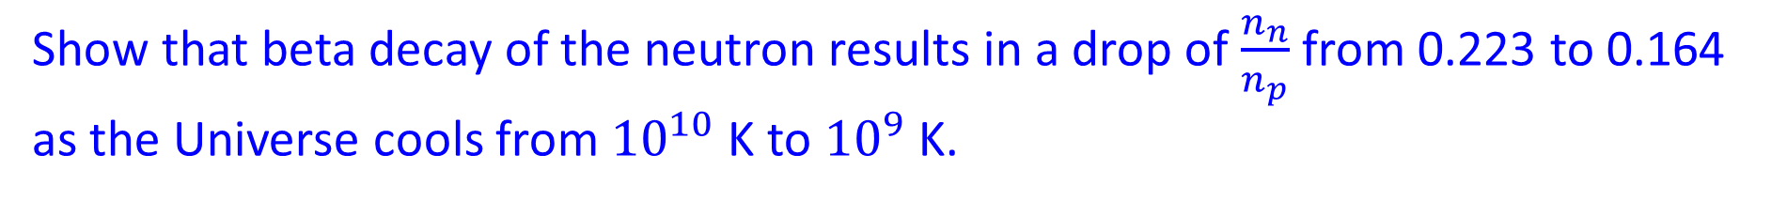
Show that beta decay of the neutron results in a drop of $\frac{n_{n}}{n_{p}}$from 0.223 to 0.164 as the Universe cools from ${10}^{10}$K to ${10}^{9}$ K.
Beta decay:
Half-life: $τ_{1/2}=617$s
Temperature-time relationship: $T\left(t\right)=1.52×{10}^{10}t^{−1/2}$

Slide 16
Compare the binding energy of ${}_{1}^{2}H$ nucleus and the characteristic energy of photons at ${10}^{9}$ K.

Slide 17
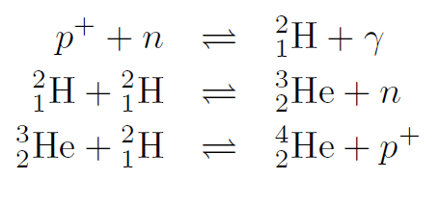
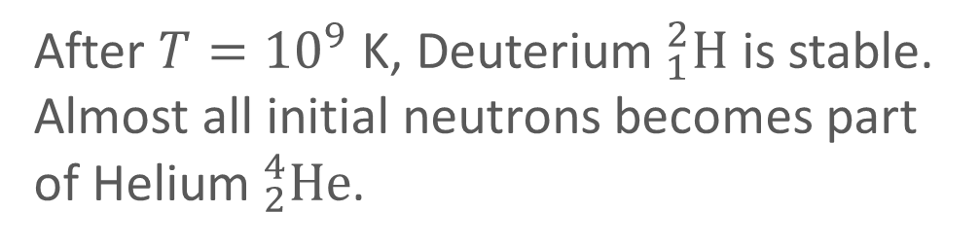
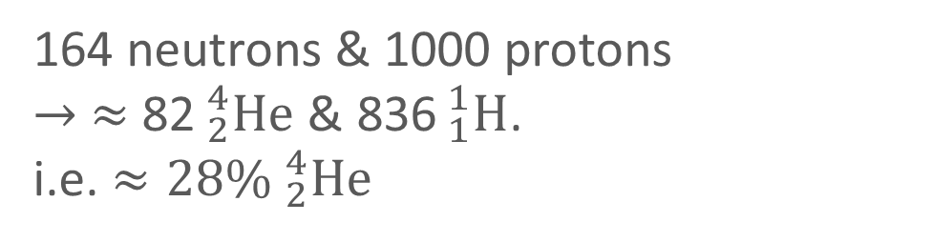
Big Bang Nucleosynthesis: Making the first elements
After $T={10}^{9}$ K, Deuterium$_{1}^{2}H$ is stable.
Almost all initial neutrons becomes part of Helium$_{2}^{4}He$.
164 neutrons & 1000 protons
$→ ≈$ 82$_{2}^{4}He$& 836$_{1}^{1}H$.
i.e. $≈28\% _{2}^{4}He$
Match with observations!

Slide 18
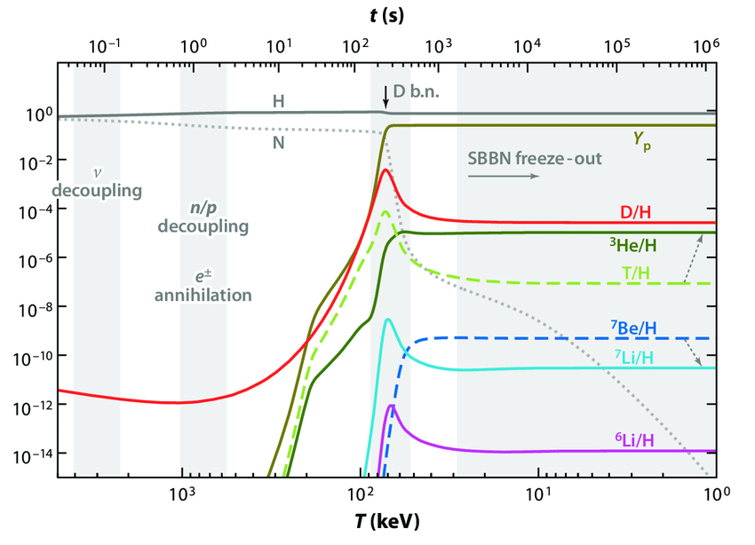
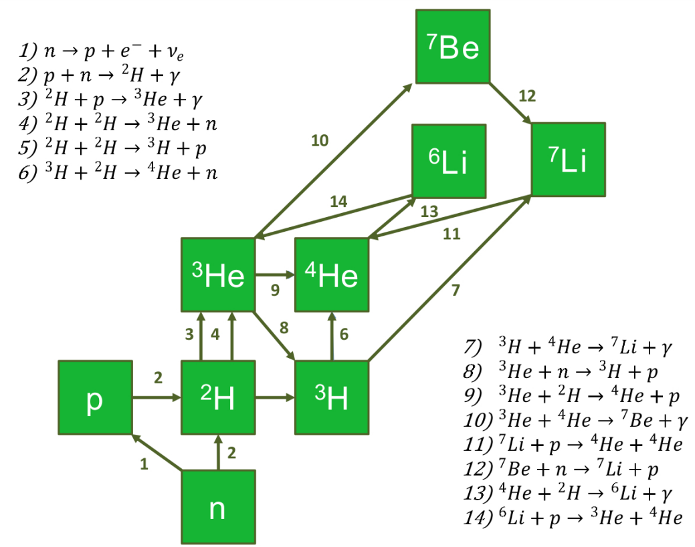
Big Bang Nucleosynthesis: Making the first elements
Nuclear reactions during Big Bang Nucleosynthesis.
arXiv:1707.07952 [nucl-ex]
Evolution of the elemental abundance in the Big Bang Nucleosynthesis.
Anders, Michael. (2013). S-factor measurement of the 2H(α,γ)6Li reaction at energies relevant for Big-Bang nucleosynthesis.

Slide 21
Fill in the table below
$$T$$ | $$k_{B}T$$ | $$\frac{n_{n}}{n_{p}}=exp\left[−\frac{(m_{n}−m_{p})c^{2}}{kT}\right]$$
$${10}^{12}K$$ | $${1.361×10}^{−11}J$$
$${10}^{11}K$$
$${10}^{10}K$$
$$Mass of Proton m_{p}=1.672622×{10}^{−27}kg$$
$$\left(m_{n}−m_{p}\right)c^{2}=$$
$$Mass of neutron m_{n}=1.674927×{10}^{−27}kg$$
$$Mass of electron m_{e}=9.109384×{10}^{−31}kg$$
$$m_{e}c^{2}=$$

